Slide 1
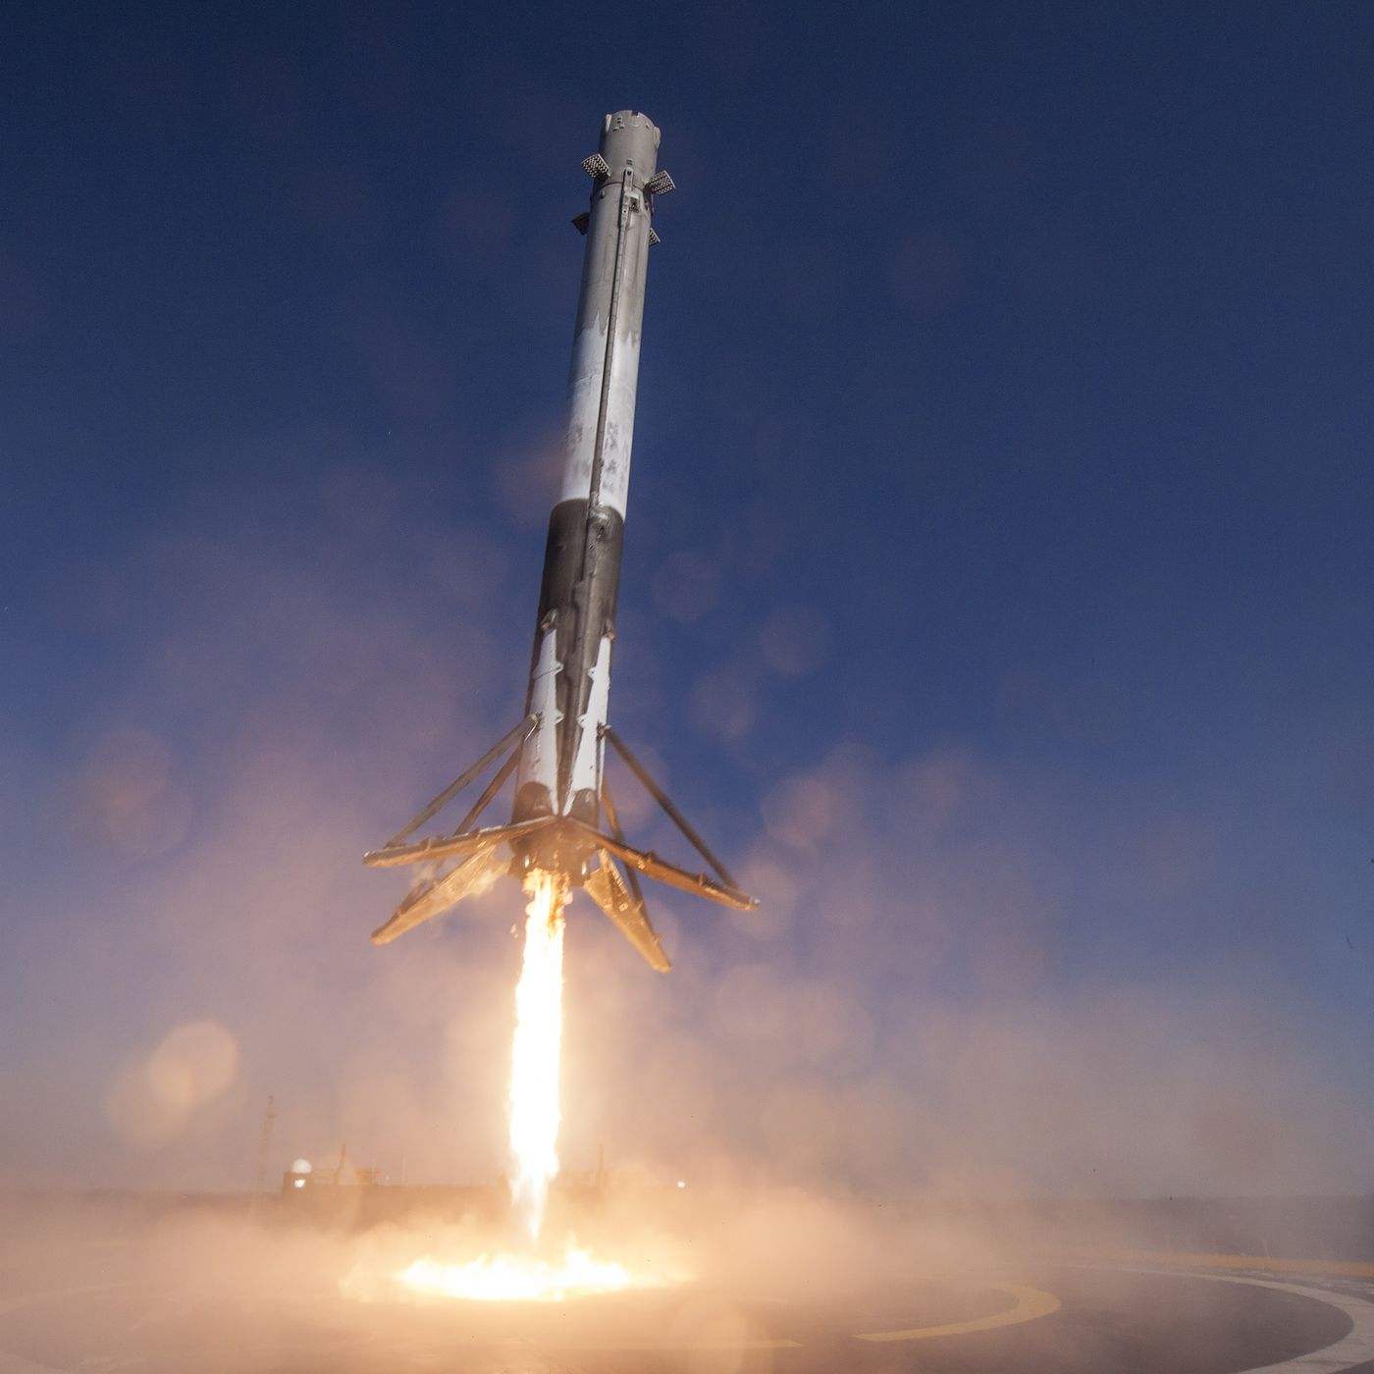






IBM DATA SCIENCE CAPSTONE PROJECT space x falcon 9 landing analysis
BHAVEEN MORAR
03/05/2022

Slide 2


OUTLINE
Executive Summary
Introduction
Methodology
Results
Visualization – Charts
Dashboard
Discussion
Findings & Implications
Conclusion
Appendix

Slide 3
EXECUTIVE SUMMARY
Summary of Methodologies:
This project follows these steps:
Data collection
Data wrangling
Exploratory data analysis
Data visualization
Machine learning prediction
Summary of Results:
This project produced the following outputs and visualizations:
Exploratory data analysis (EDA) results
Geospatial analytics
Interactive dashboard
Predictive analysis of classification models

Slide 4
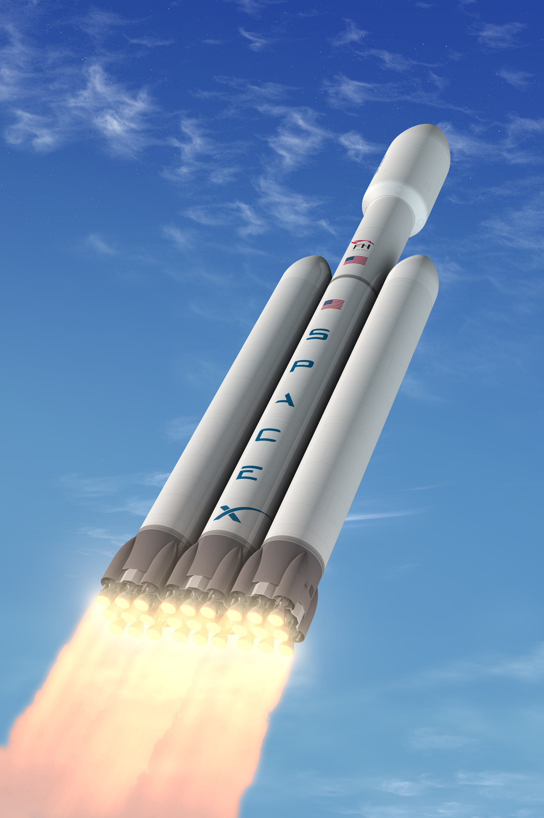
INTRODUCTION
SpaceX launches Falcon 9 rockets at a cost of around $62m. This is considerably cheaper than other providers (which usually cost upwards of $165m), and much of the savings are because SpaceX can land, and then re-use the first stage of the rocket.
If we can make predictions on whether the first stage will land, we can determine the cost of a launch, and use this information to assess whether or not an alternate company should bid and SpaceX for a rocket launch.
This project will ultimately predict if the Space X Falcon 9 first stage will land successfully.

Slide 5
METHODOLOGY
Data Collection
Making GET requests to the spacex REST API
Web scraping
Data Wrangling
Removed nan values using the .Fillna() method to
Used the method value_counts() to determine :
The number of launches on each site
The number and occurrence of each orbit
The number and occurrence of mission outcome per orbit type
Created a new landing outcome column that shows:
The booster landed successfully: ‘1’
The booster did not land successfully: ‘0’
Exploratory Data Analysis
Used SQL queries to evaluate the spacex dataset
We visualized relationships between variables and determine patterns using matplotlib.
Interactive Visual Analytics
Geospatial analytics using folium
Creating an interactive dashboard using plotly dash
Data Modelling and Evaluation
Using scikit-learn to:
Pre-process (standardize) the data
Split the data into training and testing data using train/test_split
Train different classification models
Find hyperparameters using gridsearchcv
Plotting confusion matrices for each classification model
Assessing the accuracy of each classification model

Slide 6
Data Collection
The SpaceX API was used to retrieve data about launches. This includes information about the rocket used, payload delivered, launch specifications, landing specifications, and landing outcome.
Make a GET response to the SpaceX REST API
Convert the response to a .json file then to a Pandas DataFrame
Filter the DataFrame to only include Falcon 9 launches
Reset the FlightNumber column
Replace missing values of PayloadMass with the mean PayloadMass value
Create a Pandas DataFrame from the constructed dictionary dataset
Use custom logic to clean the data
Define lists for data to be stored in
Call custom functions to retrieve data and fill the lists
Use these lists as values in a dictionary and construct the dataset
Link to workbook here
.

Slide 7
Data Collection
Web scraping was used to collect Falcon 9 historical launch records from a Wikipedia page titled List of Falcon 9 and Falcon Heavy launches.
Request the HTML page from the static URL
Assign the response to an object
Use the column names as keys in a dictionary
Use custom functions and logic to parse all launch tables to fill the dictionary values
Collect all column header names from the tables found within the HTML page
Create a BeautifulSoup object from the HTML response object
Find all tables within the HTML page
Link to workbook here
Convert the dictionary to a Pandas DataFrame ready for export
.

Slide 8
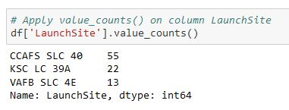
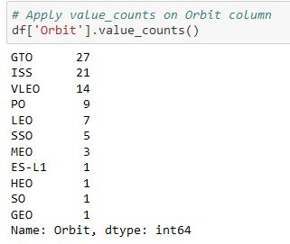

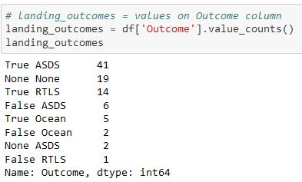
Data wrangling
The SpaceX dataset contains several Space X launch facilities, and each location is in the LaunchSite column.
Each launch aims to a dedicated orbit, and some of the common orbit types are shown in the figure below. The orbit type is in the Orbit column.
Initial Data Exploration:
Using the .value_counts() method to determine the following:
Number of launches on each site
Number and occurrence of each orbit
Number and occurrence of landing outcome per orbit type

Slide 9
Data wrangling – continued
Context:
The landing outcome is shown in the Outcome column:
True Ocean – the mission outcome was successfully landed to a specific region of the ocean
False Ocean – the mission outcome was unsuccessfully landed to a specific region of the ocean.
True RTLS – the mission outcome was successfully landed to a ground pad
False RTLS – the mission outcome was unsuccessfully landed to a ground pad.
True ASDS – the mission outcome was successfully landed to a drone ship
False ASDS – the mission outcome was unsuccessfully landed to a drone ship.
None ASDS and None None – these represent a failure to land.
Data Wrangling:
To determine whether a booster will successfully land, it is best to have a binary column, i.e., where the value is 1 or 0, representing the success of the landing.
This is done by:
Defining a set of unsuccessful (bad) outcomes, bad_outcome
Creating a list, landing_class, where the element is 0 if the corresponding row in Outcome is in the set bad_outcome, otherwise, it’s 1.
Create a Class column that contains the values from the list landing_class
Export the DataFrame as a .csv file.

Slide 10



Exploratory Data Analysis
SCATTER CHARTS
BAR CHART
LINE CHARTS
A bar chart was produced to visualize the relationship between:
Success Rate and Orbit Type
Line charts were produced to visualize the relationships between:
Success Rate and Year (i.e. the launch success yearly trend)
Scatter charts were produced to visualize the relationships between:
Flight Number and Launch Site
Payload and Launch Site
Orbit Type and Flight Number
Payload and Orbit Type

Slide 11


EDA with Data Visualization
We explored the data by visualizing the relationship between flight number and launch site, payload and launch site, success rate of each orbit type, flight number and orbit type, the launch success yearly trend.
The link to the notebook can be found here

Slide 12
Data Visualization with sql
To gather some information about the dataset, some SQL queries were performed.
The SQL queries performed on the data set were used to:
Display the names of the unique launch sites in the space mission
Display 5 records where launch sites begin with the string ‘CCA’
Display the total payload mass carried by boosters launched by NASA (CRS)
Display the average payload mass carried by booster version F9 v1.1
List the date when the first successful landing outcome on a ground pad was achieved
List the names of the boosters which had success on a drone ship and a payload mass between 4000 and 6000 kg
List the total number of successful and failed mission outcomes
List the names of the booster versions which have carried the maximum payload mass
List the failed landing outcomes on drone ships, their booster versions, and launch site names for 2015
Rank the count of landing outcomes (such as Failure (drone ship) or Success (ground pad)) between the date 2010-06-04 and 2017-03-20, in descending order

Slide 13
Geospacial analysis with folium
We marked all launch sites, and added map objects such as markers, circles, lines to mark the success or failure of launches for each site on the folium map.
We assigned the feature launch outcomes (failure or success) to class 0 and 1.I.E., 0 for failure, and 1 for success.
Using the color-labeled marker clusters, we identified which launch sites have relatively high success rate.
We calculated the distances between a launch site to its proximities. We answered some question for instance:
Are launch sites near railways, highways and coastlines.
Do launch sites keep certain distance away from cities.

Slide 14
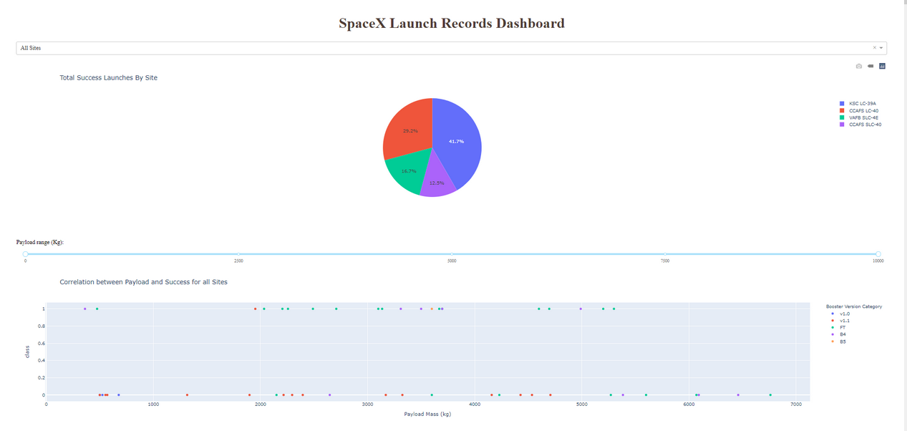
DASHBOARD APPLICATION WITH PLOTLY DASH
We built an interactive dashboard with plotly dash
We plotted pie charts showing the total launches by a certain sites
We plotted scatter graph showing the relationship with outcome and payload mass (kg) for the different booster version.

Slide 15
Predictive Analysis - Classification
The following steps were taking to develop, evaluate, and find the best performing classification model:
Model Development
Model Evaluation
Selecting Best Classification Model
To prepare the dataset for model development:
Load dataset
Perform necessary data transformations (standardise and pre-process)
Split data into training and test data sets, using train_test_split()
Decide which type of machine learning algorithms are most appropriate
For each chosen algorithm:
Create a GridSearchCV object and a dictionary of parameters
Fit the object to the parameters
Use the training data set to train the model
For each chosen algorithm:
Using the output GridSearchCV object:
Check the tuned hyperparameters (best_params_)
Check the accuracy (score and best_score_)
Plot and examine the Confusion Matrix
Review the accuracy scores for all chosen algorithms
The model with the highest accuracy score is determined as the best performing model

Slide 16
RESULTS
Exploratory data analysis results
Interactive analytics demo in screenshots
Predictive analysis results

Slide 17

Flight Number vs. Launch Site
From the plot, we found that the larger the flight amount at a launch site, the greater the success rate at a launch site.

Slide 18


Payload vs. Launch Site

Slide 19

Success Rate vs. Orbit Type
From the plot, we can see that ES-L1, GEO, HEO, SSO, VLEO had the most success rate.

Slide 20

Flight Number vs. Orbit Type
The plot below shows the Flight Number vs. Orbit type. We observe that in the LEO orbit, success is related to the number of flights whereas in the GTO orbit, there is no relationship between flight number and the orbit.

Slide 21

Payload vs. Orbit Type
We can observe that with heavy payloads, the successful landing are more for PO, LEO and ISS orbits.

Slide 22
Launch Success Yearly Trend
From the plot, we can observe that success rate since 2013 kept on increasing till 2020.

Slide 23

All Launch Site Names
We used the key word DISTINCT to show only unique launch sites from the SpaceX data.
.

Slide 24

Launch Site Names Begin with 'CCA'
We used the query above to display 5 records where launch sites begin with `CCA`
.

Slide 25

Total Payload Mass
We calculated the total payload carried by boosters from NASA as 45596 using the query below
.

Slide 26

Average Payload Mass by F9 v1.1
We calculated the average payload mass carried by booster version F9 v1.1 as 2928.4
.

Slide 27

First Successful Ground Landing Date
We observed that the dates of the first successful landing outcome on ground pad was 22nd December 2015
.

Slide 28

Successful Drone Ship Landing with Payload between 4000 and 6000
We used the WHERE clause to filter for boosters which have successfully landed on drone ship and applied the AND condition to determine successful landing with payload mass greater than 4000 but less than 6000

Slide 29

Total Number of Successful and Failure Mission Outcomes
We used wildcard like ‘%’ to filter for WHERE MissionOutcome was a success or a failure.

Slide 30

Boosters Carried Maximum Payload
We determined the booster that have carried the maximum payload using a subquery in the WHERE clause and the MAX() function.

Slide 31

2015 Launch Records
We used a combinations of the WHERE clause, LIKE, AND, and BETWEEN conditions to filter for failed landing outcomes in drone ship, their booster versions, and launch site names for year 2015

Slide 32

Rank Landing Outcomes Between
2010-06-04 and 2017-03-20
We selected Landing outcomes and the COUNT of landing outcomes from the data and used the WHERE clause to filter for landing outcomes BETWEEN 2010-06-04 to 2010-03-20.
We applied the GROUP BY clause to group the landing outcomes and the ORDER BY clause to order the grouped landing outcome in descending order.

Slide 33




ALL LAUNCH SITES ON A MAP
All SpaceX launch sites are on coasts of the United States of America, specifically Florida and California.

Slide 34





SUCCESS/FAILED LAUNCHES FOR EACH SITE
Launches have been grouped into clusters, and annotated with green icons for successful launches, and red icons for failed launches.
CCAFS SLC-40 and CCAFS LC-40
VAFB SLC-4E
KSC LC-39A

Slide 35
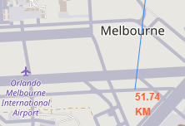
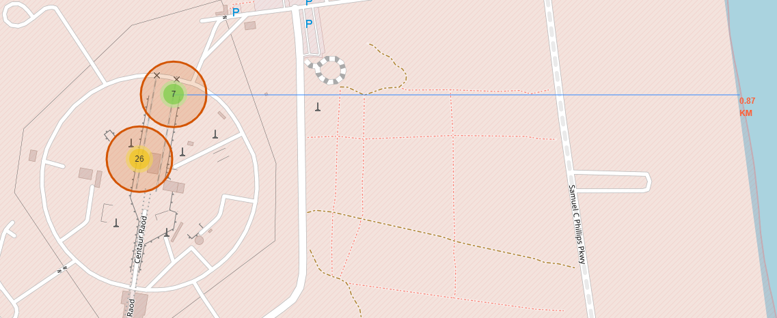
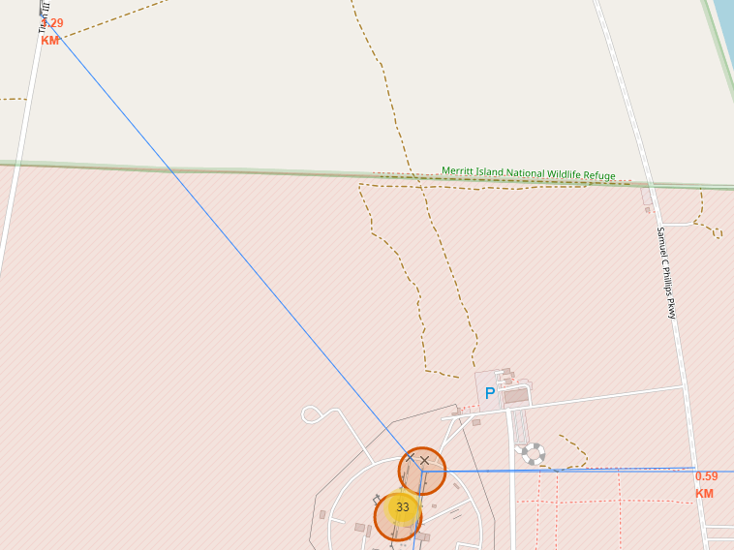
PROXIMITY OF LAUNCH SITES TO OTHER POINTS OF INTEREST
Are launch sites in close proximity to railways?
YES. The coastline is only 0.87 km due East.
Are launch sites in close proximity to highways?
YES. The nearest highway is only 0.59km away.
Are launch sites in close proximity to railways?
YES. The nearest railway is only 1.29 km away.
Do launch sites keep certain distance away from cities?
YES. The nearest city is 51.74 km away.
Using the CCAFS SLC-40 launch site as an example site, we can understand more about the placement of launch sites.

Slide 36
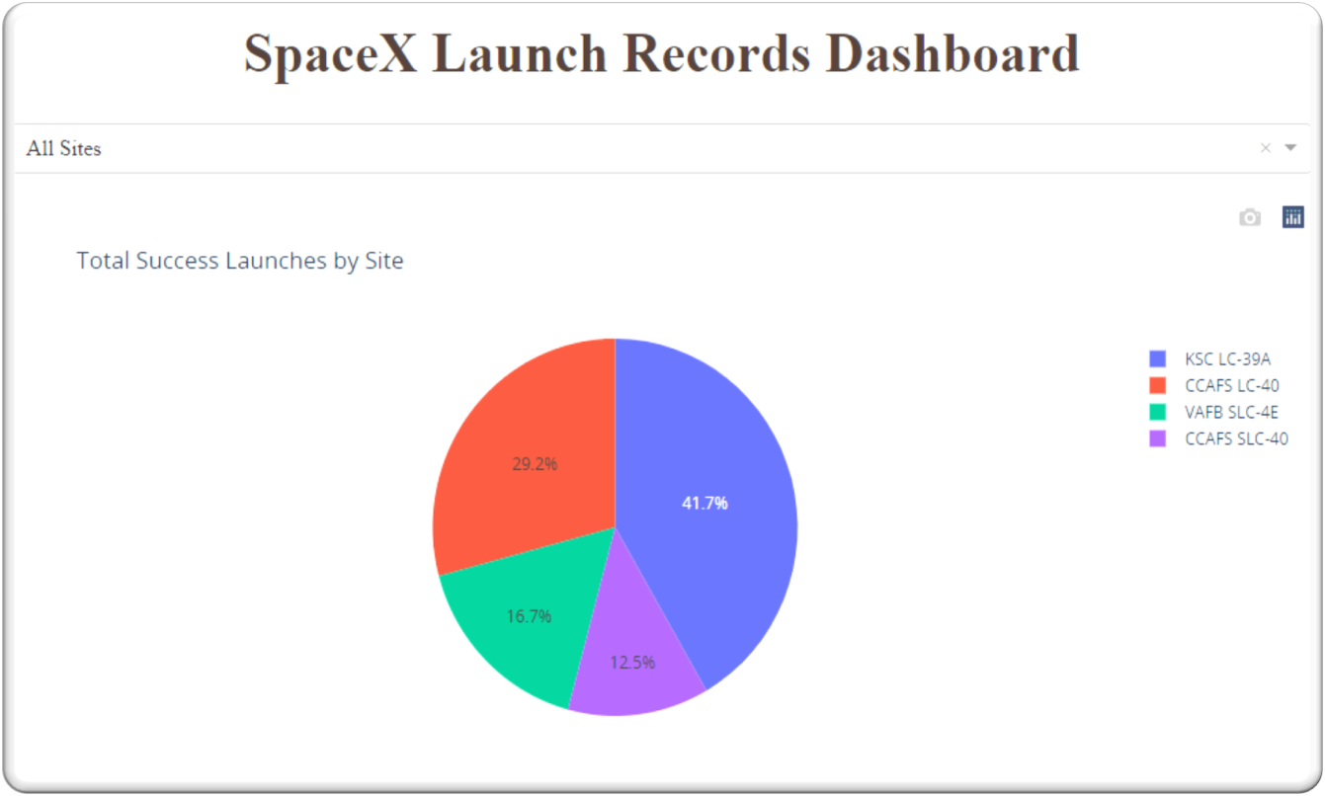
Interactive DASHBOARD with plotly dash

Slide 37

DASHBOARD TAB 1
The launch site KSC LC-39 A had the most successful launches, with 41.7% of the total successful launches.

Slide 38

DASHBOARD TAB 2
Pie chart for the launch site with highest launch success ratio
The launch site KSC LC-39 A also had the highest rate of successful launches, with a 76.9% success rate.

Slide 39

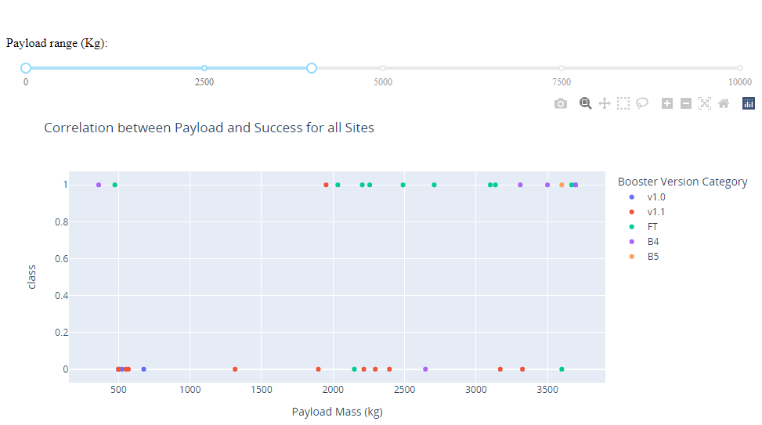
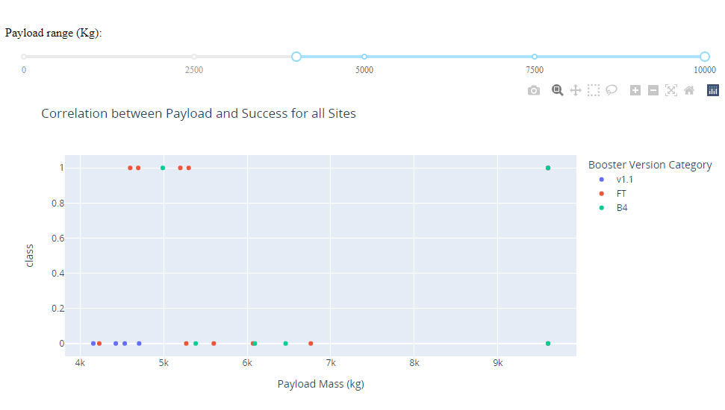
DASHBOARD TAB 3
Plotting the launch outcome vs. payload for all sites shows a gap around 4000 kg, so it makes sense to split the data into 2 ranges:
0 – 4000 kg (low payloads)
4000 – 10000 kg (massive payloads)
From these 2 plots, it can be shown that the success for massive payloads is lower than that for low payloads.
It is also worth noting that some booster types (v1.0 and B5) have not been launched with massive payloads.

Slide 40

Classification Accuracy
The decision tree classifier is the model with the highest classification accuracy

Slide 41
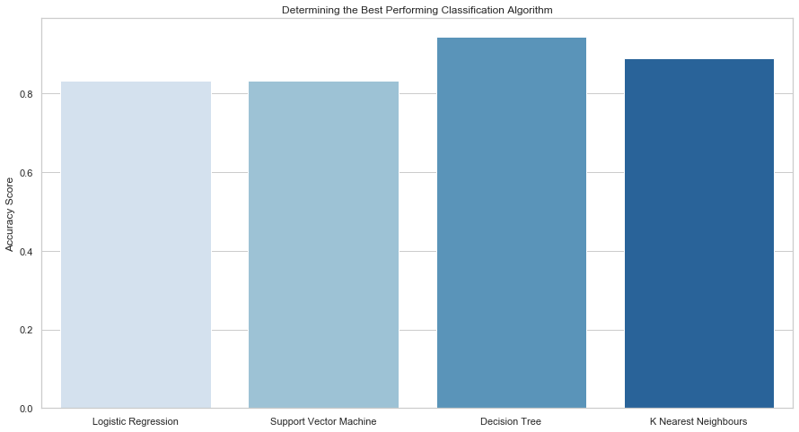
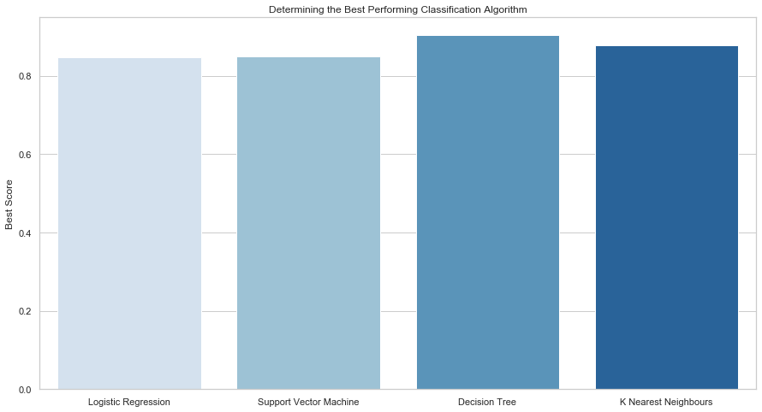
Classification Accuracy

Slide 42

The confusion matrix for the decision tree classifier shows that the classifier can distinguish between the different classes. The major problem is the false positives .i.e., unsuccessful landing marked as successful landing by the classifier
Confusion Matrix

Slide 43
CONCLUSION
We can conclude that:
The larger the flight amount at a launch site, the greater the success rate at a launch site.
Launch success rate started to increase in 2013 till 2020.
Orbits es-l1, geo, heo, sso, vleo had the most success rate.
Ksc lc-39a had the most successful launches of any sites.
The decision tree classifier is the best machine learning algorithm for this task.

